Slide 1

Air Quality Prediction and Monitoring Using Machine Learning
Presented By
K.CHANDRIKA
MENTOR
Mrs D Sameera
M.SIVA DURGA PRASAD

Slide 2
Table Of Contents
Abstract
Introduction
Overview
Importance
Methodology
Model Selection
Implementation
Results
Challenges
Future Work
Conclusion

Slide 3
Abstract
This study explores the application of machine learning in Air Quality Index (AQI) monitoring.
Traditional AQI prediction methods face limitations in accuracy and adaptability.
Machine learning techniques enhance forecasting capabilities using real-time and historical data.
Various models such as regression, random forests, and deep learning are evaluated.
The findings highlight improvements in prediction accuracy and the need for further advancements in real-time monitoring.

Slide 4
Introduction
Air pollution is a critical environmental issue.
Economic Consequences: Air pollution leads to increased healthcare costs and reduced workforce productivity.
The Air Quality Index (AQI) helps assess pollution levels.
Machine learning enhances AQI prediction and monitoring.

Slide 5
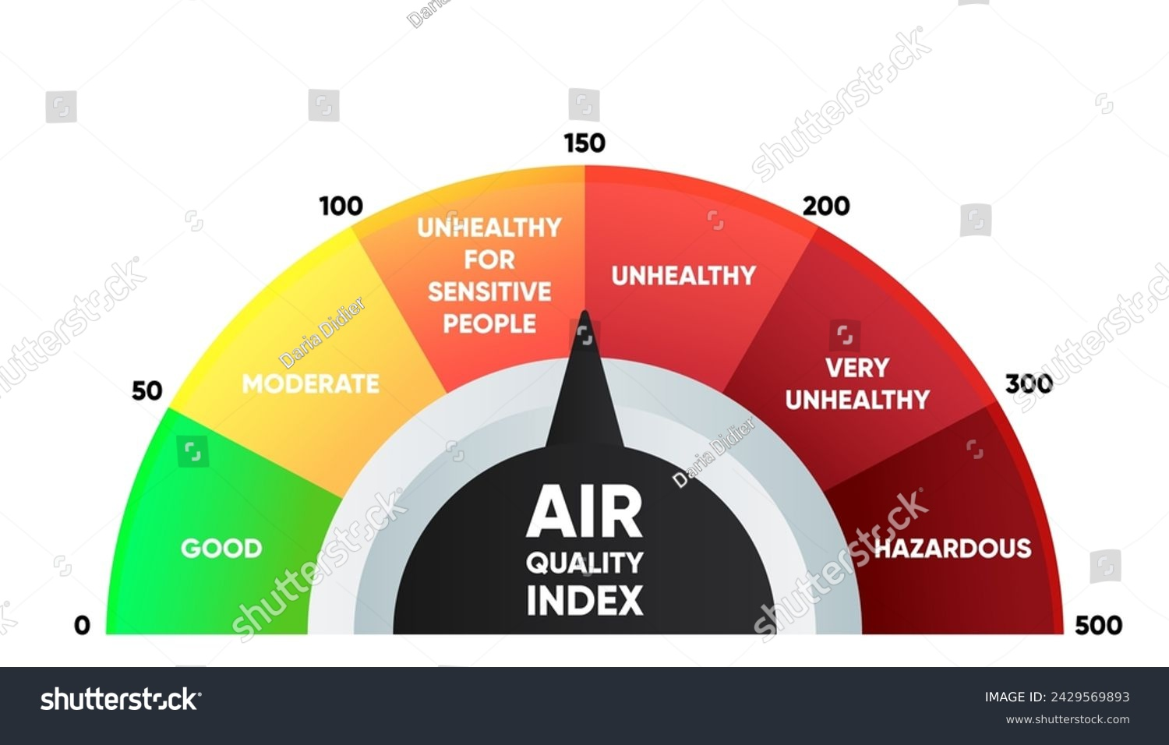
Air Quality Index (AQI) Overview
AQI categorizes air pollution levels.
Major pollutants: PM2.5, PM10, NO2, SO2, CO, O3.
High AQI values indicate worse air quality.
AQI Scale: Ranges from 0 to 500
AQI 0-50 (Good)
AQI 51-100 (Moderate)
AQI 101-150 (Unhealthy for Sensitive Groups)
AQI 151+ (Unhealthy/Hazardous)
Real-Time Monitoring: Sensors and satellite data help track AQI changes throughout the day

Slide 6
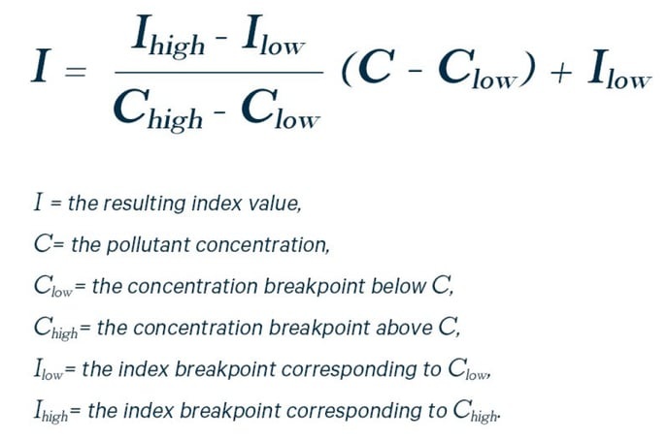

Slide 7
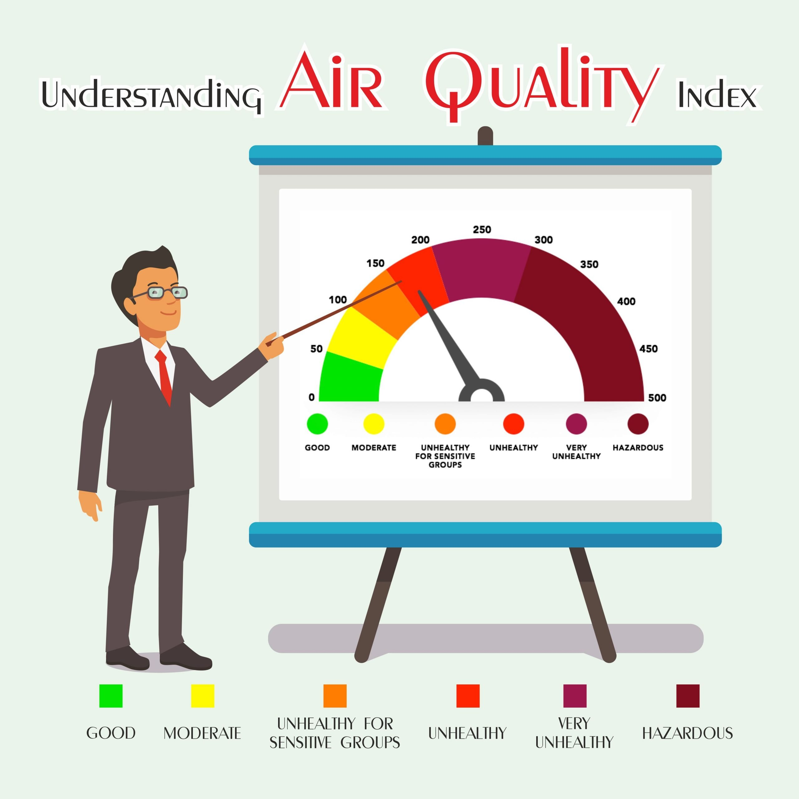

Slide 8
Importance of Air Quality Monitoring
Helps in public health awareness.
Supports policy-making and pollution control.
Provides real-time data for better decision-making.

Slide 9
Machine Learning in AQI Prediction
Uses past data to predict future AQI levels.
Common techniques: Regression, Decision Tree, Random Forest.
Improves accuracy compared to traditional models.
Faster and more precise than traditional statistical methods.
Helps policymakers take proactive measures against pollution spikes.
Enables smart city planning by identifying high-risk pollution zones.

Slide 10
Project Architecture
1. Data Collection & Preprocessing
2. Exploratory Data Analysis (EDA) & Feature Selection
3. Model Selection & Training
4. Model Evaluation & Metrics

Slide 11
Methodology & Dataset
Data collected from air quality monitoring stations.
Extracted the data of delhi city .
Features include pollutant concentrations, meteorological data.
Data preprocessing:
Handling missing values, normalization.

Slide 12
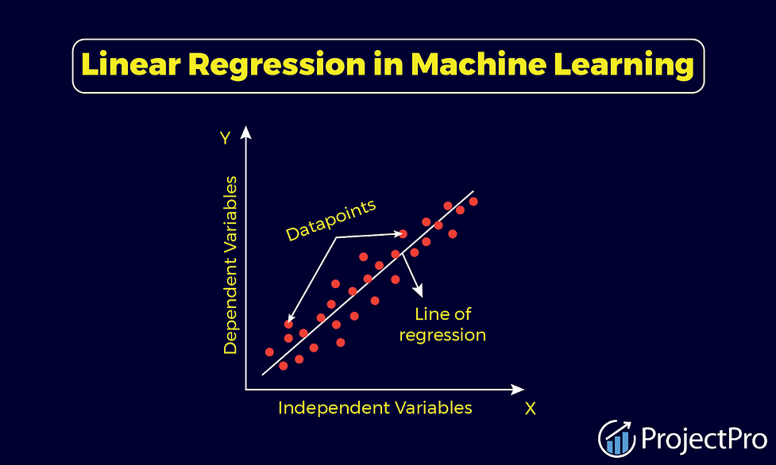

Model Selection & Implementation
Models tested: Linear Regression, Random Forest, Decision Tree.
Feature selection and model tuning.
Performance metrics: RMSE, R² Score.

Slide 13
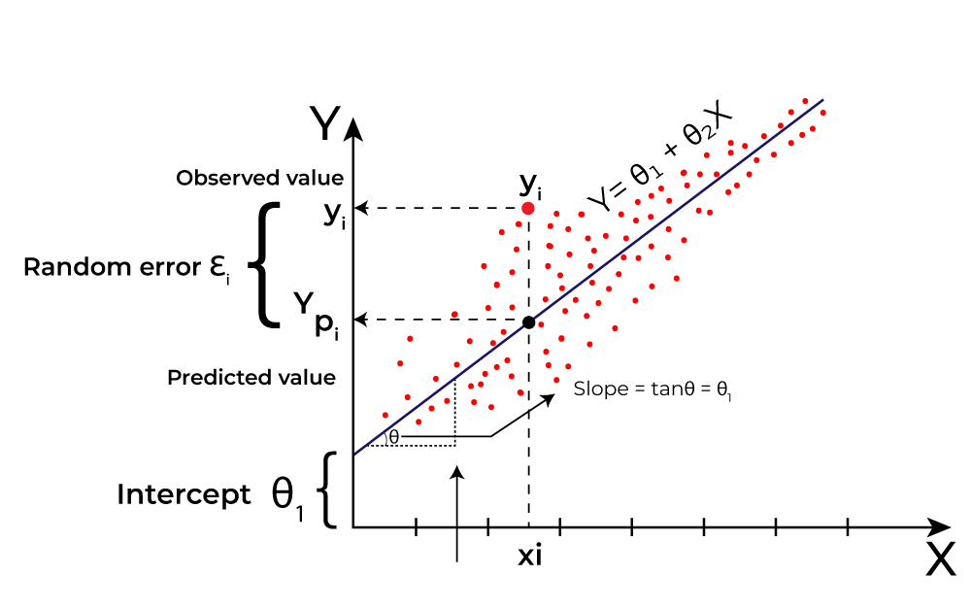
1.Linear Regression
Linear regression is a supervised learning algorithm used for predicting continuous values.
It establishes a relationship between dependent and independent variables.
Finds the best-fit line by
minimizing the sum of
squared residuals .
. Adjusts slope and intercept
to minimize prediction error

Slide 14
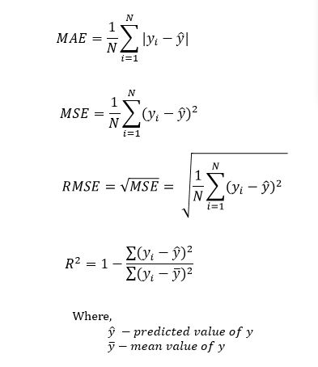
Evaluation Metrics
Mean Squared Error (MSE)
Root Mean Squared Error (RMSE)
Mean Absolute Error (MAE)
R-squared (R2R^2R2) – Measures goodness of fit

Slide 15
2.Decision Tree
Decision Tree Regressor is a supervised learning algorithm used for predicting continuous values.
It splits the data into smaller subsets and makes predictions based on tree-like structures.
Works well for non-linear relationships.
Splits data into nodes based on feature values

Slide 16
Implementation
Sample code snippet:
import pandas as pd
import numpy as np
import seaborn as sns
matplotlib.pyplot as plt
import warnings
warnings.filterwarnings("ignore")
from sklearn.preprocessing import LabelEncoder
from sklearn.model_selection import train_test_split
from sklearn.linear_model import LinearRegression
from sklearn.tree import DecisionTreeRegressor
from sklearn.ensemble import RandomForestRegressor
from sklearn import metrics
from sklearn.metrics import mean_absolute_error,mean_squared_error,r2_score

Slide 17
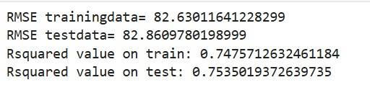
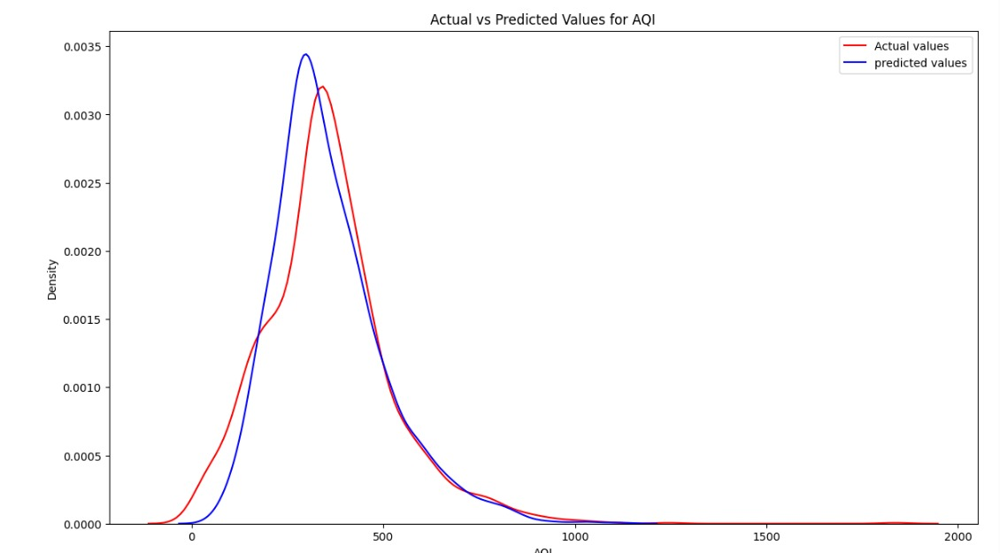

Slide 18
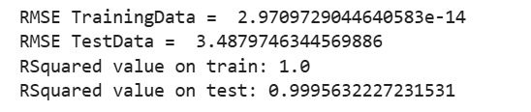
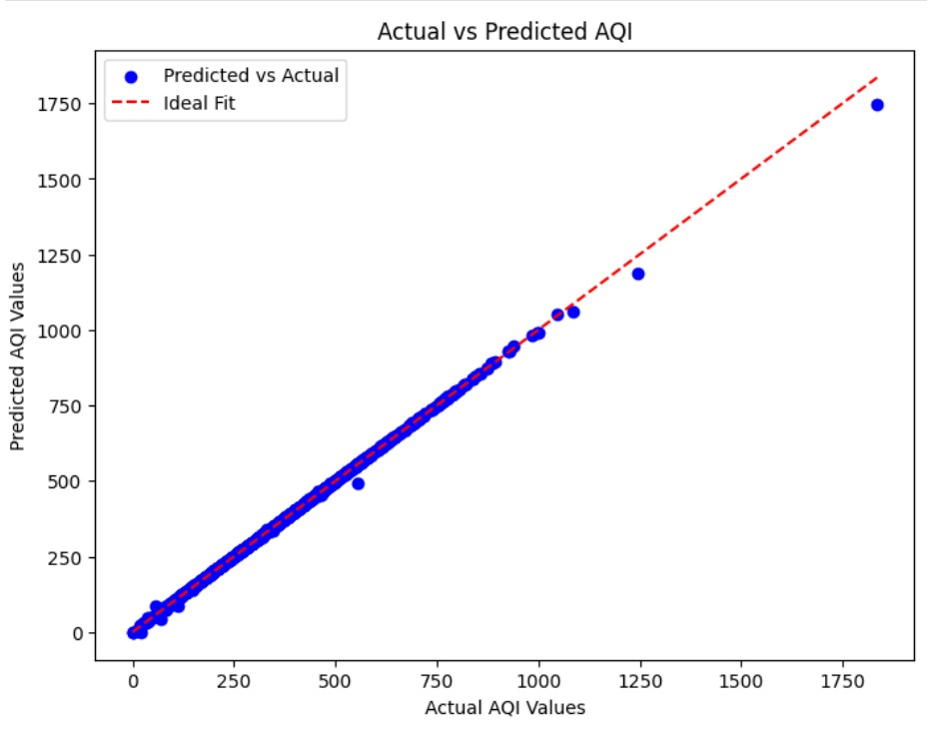

Slide 19
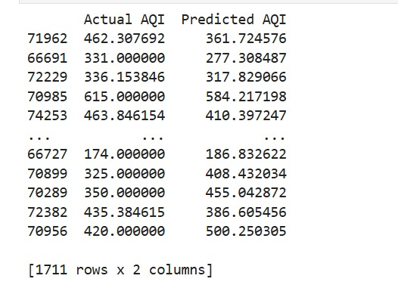
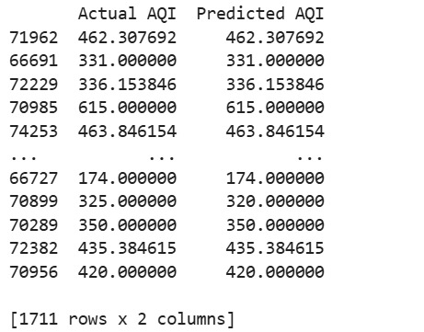
Results & Discussion
AQI values based on linear regression
AQI based on decision tree
Accuracy comparison of different models.
Key findings from prediction analysis.
Limitations and areas for improvement.

Slide 20
Challenges & Limitations
Data availability and quality issues.
Computational challenges for complex models.
Need for real-time processing improvements.

Slide 21
Future Work
Enhancing model accuracy with decision tree and
neural networking .
Integration for real-time monitoring.
Developing a user-friendly AQI forecasting application.
classify AQI values as good /bad

Slide 22
Conclusion & References
Machine learning improves AQI monitoring.
Further research needed for real-time implementation.
References: [KAGGLE and OPEN WEATHER].

Slide 23

THE END

